Slide 1
Engenharia de Software Experimental
DSL - Mapeamento Sistemático da Literatura: Ferramentas de apoio
Anibal Neto, João Carbonell

Slide 2
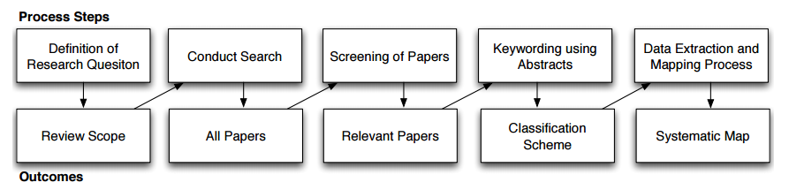
Protocolo

Slide 3
Strings de busca
String genérica
(DSL or DSML or "Domain Specific Language" or "Domain-Specific Language" or "Domain-Specific-Language" or "Domain Specific-Language" or "Little-Language" or "Little Language" or "Small-Language" or "Small Language" or "Domain Specific Modeling Language" or "Domain-specific Modeling Language" or "Domain-Specific-Modeling-Language" or "Domain-Specific Modeling-Language") and (tool or tools or "Language Workbench" )

Slide 4
Strings de busca
IEEE
String DSL
(((((DSL OR "Domain Specific Language" OR "Domain-Specific Language" OR "Domain-Specific-Language" “Domain Specific-Language” OR "Small Language" OR "Small-Language" OR "Little-Language" OR "Little Language") AND (Tools OR "Language Workbench")))))
String DSMl
(((DSML OR "Domain Specific-Language" OR "Domain Specific Modeling Language" OR "Domain-Specific Modeling-Language" OR "Domain Specific Modeling-Language") AND (Tools OR "Language Workbench")))

Slide 5
Strings de busca
Scopus
(TITLE-ABS-KEY ( dsl OR dsml OR "domain specific language" OR "domain-specific language" OR "domain-specific-language" OR "domain specific language" OR "domain specific modeling language" OR "domain-specific modeling language" OR "domain specific modeling-language" OR "domain-specific-modeling-language") AND TITLE-ABS-KEY (tool OR tools OR "language workbench")) AND (LIMIT-TO (LANGUAGE , "English" ) )

Slide 6
Strings de busca
ACM CL*
((acmdlTitle:("DSL" "Domain Specific Language" "Domain-Specific Language" "Domain-Specific-Language" "Domain Specific-Language" "Little-Language" "Little Language" "Small-Language" "Small Language"))) OR (recordAbstract:("DSL" "Domain Specific Language" "Domain-Specific Language" "Domain-Specific-Language" "Domain Specific-Language" "Little-Language" "Little Language" "Small-Language" "Small Language")) AND ((acmdlTitle:("tool" "tools" "Language Workbench")) OR (recordAbstract:("tool" "Language Workbench")))

Slide 7
Strings de busca
Science direct
TITLE-ABSTR-KEY(DSL or DSML or "Domain Specific Language" or "Domain-Specific Language" or "Domain-Specific-Language" or "Domain Specific-Language" or "Little-Language" or "Little Language" or "Small-Language" or "Small Language" or "Domain Specific Modeling Language" or "Domain-specific Modeling Language" or "Domain-Specific-Modeling-Language" or "Domain-Specific Modeling-Language") and TITLE-ABSTR-KEY(tool or tools or "Language Workbench" )
Enginnering village(Compendex)
(((DSL) OR (DSML) OR ("Domain Specific Language") OR ("Domain-Specific Language") OR ("Domain-Specific-Language") OR ("Small Language") OR ("Small-Language") OR ("Little-Language") OR ("Little Language") OR ("Domain Specific Modeling Language") OR ("Domain-Specific Modeling Language") OR ("Domain-Specific-Modeling-Language") OR ("Domain-Specific Modeling-Language" OR “Domain Specific Modeling-Language”) WN KY) AND (tool) OR ("Language Workbench") WN KY) AND (({English}) WN LA)

Slide 8
Strings de busca
Springer Link
((DSL or DSML "domain specific language" or "domain-specific language" or "domain-specific-language" OR ("Small Language") OR ("Small-Language") OR ("Little-Language") OR ("Little Language") OR ("Domain Specific Modeling Language") OR ("Domain-Specific Modeling Language") OR ("Domain-Specific-Modeling-Language") OR ("Domain-Specific Modeling-Language" OR “Domain Specific Modeling-Language”) and (tool or tools or language workbench))

Slide 9
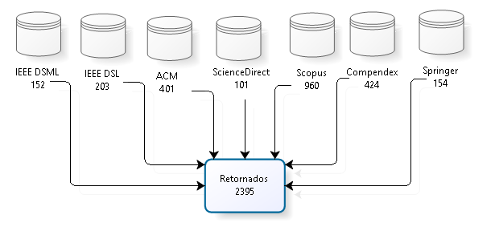
Retornos das buscas

Slide 10
Cruzamento de resultados
Compendex
28
Science Direct
23
ACM
Scopus
21
64
Springer
0
IEEE
0

Slide 11
Cruzamento de resultados
Compendex
20
ScienceDirect
0
ACM
SPRINGER
107
14
41
IEEE
0
Scopus

Slide 12
Cruzamento de resultados
Springer
20
ScienceDirect
0
Compendex
29
ACM
14
369
IEEE
0
Scopus

Slide 13
Cruzamento de resultados
Compendex
151
ACM
ScienceDirect
IEEE
33
111
1
285
Springer
0
Scopus

Slide 14
Cruzamento de resultados
Compendex
136
IEEE
63
ScienceDirect
ACM
89
28
Springer
14
272
Scopus

Slide 15
Cruzamento de resultados
Compendex
367
ACM
ScienceDirect
Scopus
352
260
29
41
Springer
75
IEEE

Slide 16
Próximos passos
Retirar duplicados
Aplicar critérios de inclusão e exclusão

Slide 17
OBRIGADO!

